Slide 1




April 03, 2020
3

Slide 2
Agenda: MSBI.Dev.PowerBI.S20E02
2. Data Modelling in Power BI Desktop
· Introduction
· Managing Data Relationships
· Creating Calculated Columns
· Optimizing Models for Reporting
· Creating Calculated Measures
· Creating and Managing Hierarchies
· Using Calculated Tables
· Time Intelligence
· Manually Typing in a Data Table
· Include / Exclude
· Grouping / Binning
· Summary
3

Slide 3
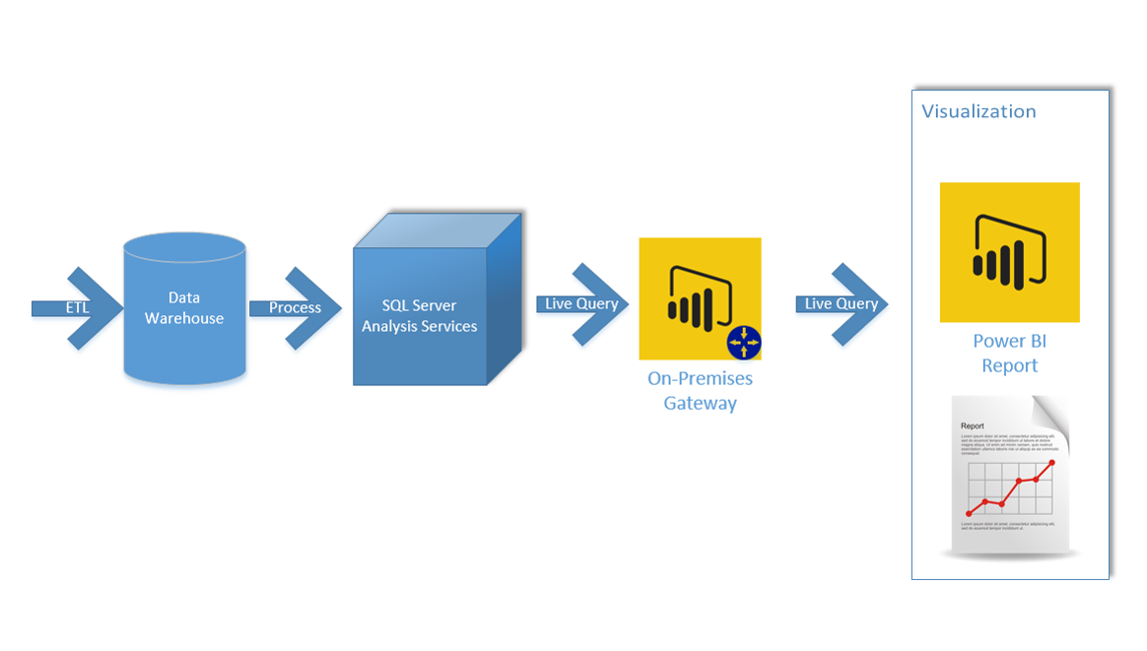
Enterprise Architecture for Power BI

Slide 4
Managing Data Relationships
Both-Directional relationship is one of the ways you can kill the performance of your Power BI Model!
Ambiguity might be very well hidden
How to avoid both-directional relationships:
Method 1: Change the Data Model! Design Appropriately
Method 2: Using CrossFilter DAX function ONLY IF the first method does not work
http://radacad.com/what-is-the-direction-of-relationship-in-power-bi
3

Slide 5
Optimizing Models for Reporting
Why should we remove redundant columns in Power Query?
Why should we hide redundant columns in Report?
Do you need a date dim?
Powerful Slice and Dice by quarter, weekday
Consistency in Analysis Date Dimension on the other hand is a dimension that is shared between all fact tables
DAX time intelligence functions won’t work properly if you don’t have a proper date dimension. proper date dimension is a table that has a full date column in one of the fields, and has no gaps in dates
http://radacad.com/do-you-need-a-date-dimension
3

Slide 6
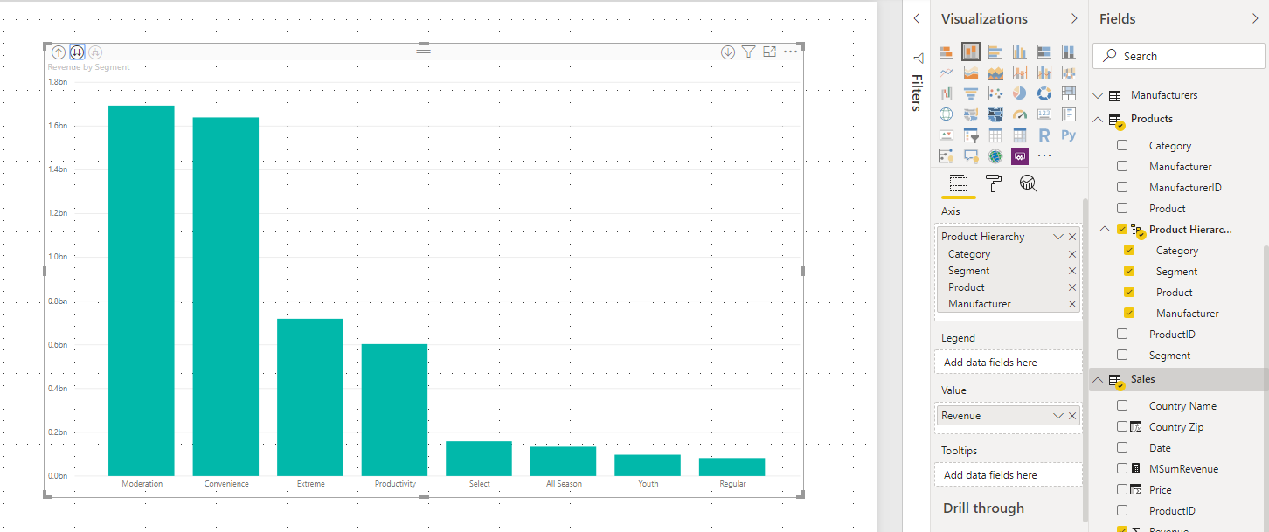
Hierarchies
Can help aggregate and show data on each level using Drill up and Drill down functions
Hierarchies
3

Slide 7
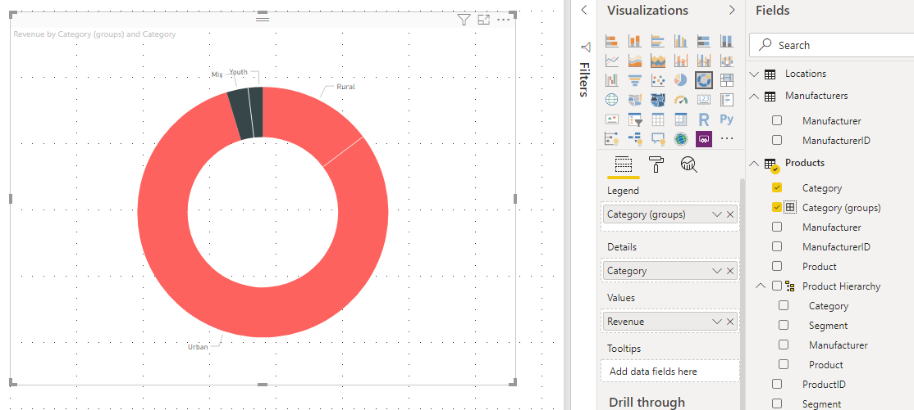
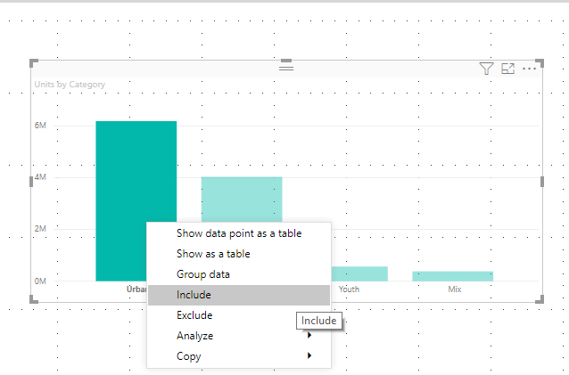
Other useful features
Grouping and binning
Include/Exclude
3

Slide 8
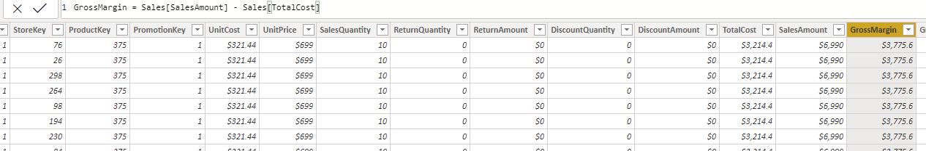
Calculated Columns
The content of the columns is defined by a DAX expression evaluated row by row. They are computed during the database processing and then stored in the model.
Example:
GrossMargin = Sales[SalesAmount] - Sales[TotalCost]
GrossMarginPct = DIVIDE (Sales[GrossMargin], Sales[SalesAmount] )
What is DAX?
DAX is a collection of functions, operators, and constants that can be used in a formula, or expression, to calculate and return one or more values.
3

Slide 9
Measures
Calculations in a DAX to aggregate values from many rows in a table.
Measures are evaluated at query time it does not consume memory and disk space.
Examples:
Total Sales = SUM(Sales[SalesAmount])
GrossMarginPct = DIVIDE (SUM(Sales[GrossMargin]), SUM(Sales[SalesAmount]) )
GrossMargin = SUM(Sales[SalesAmount]) - SUM(Sales[TotalCost])
Previous Quarter Sales = CALCULATE([Total Sales], PREVIOUSQUARTER(Calendar[DateKey]))
3

Slide 10
Use cases
Define a calculated column if you want to do the following:
1) Place the calculated results in a slicer or see results in rows or columns in a pivot table (as opposed to the values area), or in the axes of a chart, or use the result as a filter condition in a DAX query.
2) Define an expression that is strictly bound to the current row.
For example, Price * Quantity cannot work on an average or on a sum of the two columns.
3) Categorize text or numbers. For example, a range of values for a measure, a range of ages of customers, such as 0–18, 18–25, and so on.
Define a measure if you want to display resulting calculation values that reflect user selections and see them in the values area of a pivot table, or in the plot area of a chart.
3

Slide 11
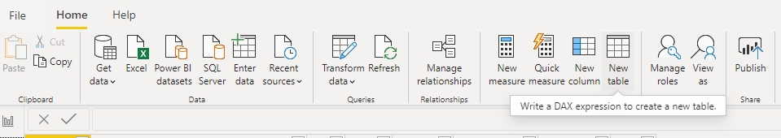
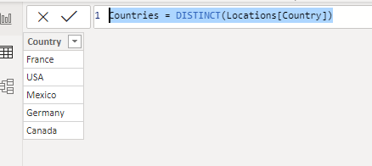
Calculated Tables
DAX expressions can help to create tables too:
Calendar = CALENDAR (DATE (2005, 1, 1), DATE (2020, 12, 31))
Example:
Countries = DISTINCT(Locations[Country])
3

Slide 12
Basic DAX functions
Aggregation Functions (SUM, MIN, MAX, AVERAGE etc)
Total Sales=SUM(Sales[Revenue])
‘X’ Aggregation Functions (SUMX, MINX, MAXX, AVERAGEX etc)
Total Sales=SUMX(Sales, [Sales]*[Quantity])
VAR Function
Time Intelligence Functions
Text Functions
FILTER Functions (FILTER, ALL, RELATEDTABLE, etc)
USA Sales = FILTER (Sales, Sales[Country Name] = “USA”)
CALCULATE
https://docs.microsoft.com/en-us/dax/
3

Slide 13
Quality Of Life Report
Column
GroupValue = SWITCH(TRUE(), FactQualityOfLife[Value] >= 100, 100, FactQualityOfLife[Value] >= 80, 80, FactQualityOfLife[Value] >= 60, 60, FactQualityOfLife[Value] >= 40, 40, FactQualityOfLife[Value] >= 20, 20, 0)
Mesure
Create Measure Max Quality Of life Index value
Example:
Avg Safety Index = CALCULATE(AVERAGE(FactQualityOfLife[Value]), FILTER(DimIndexType, DimIndexType[IndexType] = "Safety Index"))

